Slide 1


Md Kauser Ahmmed
10/12/2025

Slide 2

Outline
Executive Summary
Introduction
Methodology
Results
Conclusion
Appendix

Slide 3
Executive Summary
Goal: Predict whether a SpaceX Falcon 9 launch is successful (or landing success) using mission and hardware features
Methods: Collected data via SpaceX APIs + scraped additional data, cleaned and merged, EDA including SQL queries and interactive maps, built classification models.
Key result: Decision Tree achieved ~86% accuracy
Insight: Some launch sites + payload mass ranges show significantly higher success rates
Recommendation: Use model insights to inform launch planning and future data collection

Slide 4
Introduction
Background: SpaceX aims to reuse boosters and reduce launch cost; landing success is critical
Problem: What factors influence whether a launch results in a successful landing?
Research question: Can we predict success from features such as payload mass, orbit, boosters, and site?
Stakeholder value: Insights could help mission planners, investors, or engineers

Slide 5

Section 1

Slide 6
Methodology
Executive Summary
Data collection methodology:
Source 1: SpaceX REST API (for mission, launch, booster data). https://api.spacexdata.com
Source 2: Web scraping
Perform data wrangling
Handle Missing Values. Merged data into unified dataframe, Converted categorical variable into dummy variable using one hot encoding, Scaled numerical values. Notebook: data_wrangling.ipynb
Perform exploratory data analysis (EDA) using visualization and SQL: Notebook
Perform interactive visual analytics using Folium and Plotly Dash: Notebook
Perform predictive analysis using classification models: Notebook
Build models (Logistic regression, Decision Tree), tune, evaluate classification models.

Slide 7
Data Collection
API
Request to the SpaceX API (https://api.spacexdata.com). Basic data wrangling and formatting.
Clean the requested data.
Web Scrapping:
https://en.wikipedia.org/wiki/List_of_Falcon_9_and_Falcon_Heavy_launches
Extract Falcon 9 launch records HTML table from Wikipedia
Parse table and convert it into a Pandas data frame

Slide 8
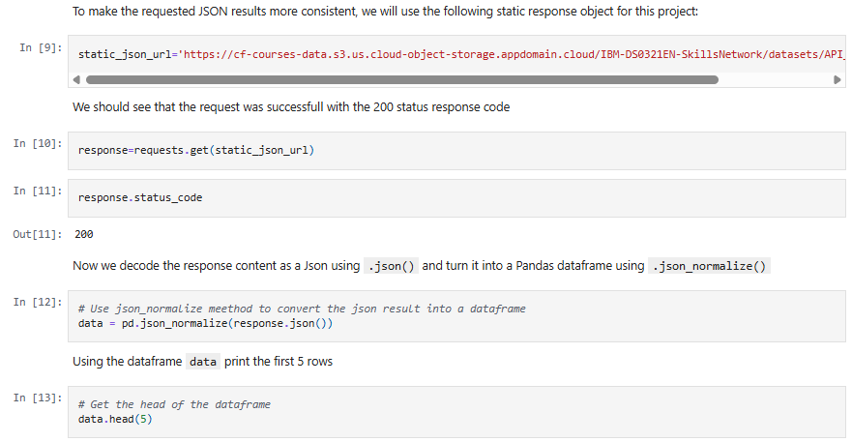
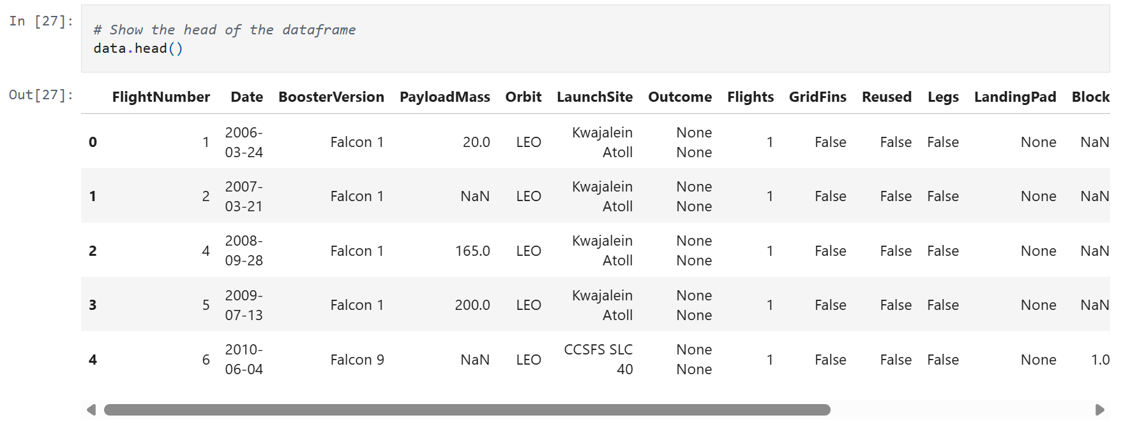
Data Collection – SpaceX API
Data is collected with SpaceX REST calls. Then the requested data is cleaned into proper usable format.
GitHub URL of the completed SpaceX API calls
Notebook: jupyter-labs-spacex-data-collection-api.ipynb

Slide 9
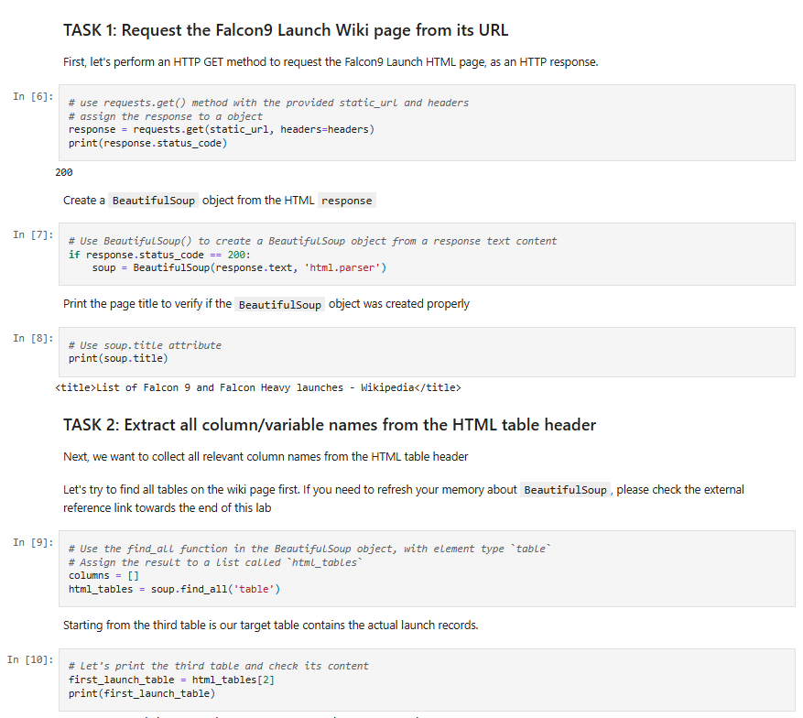
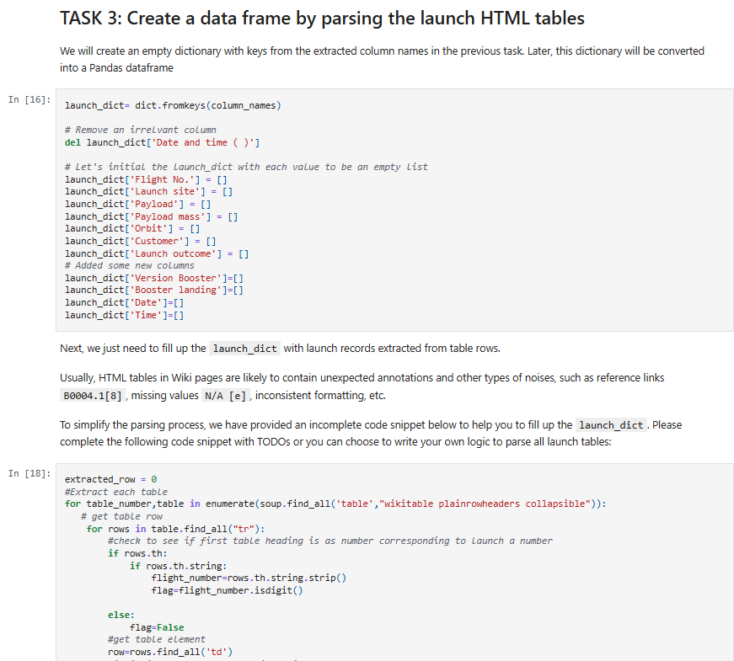
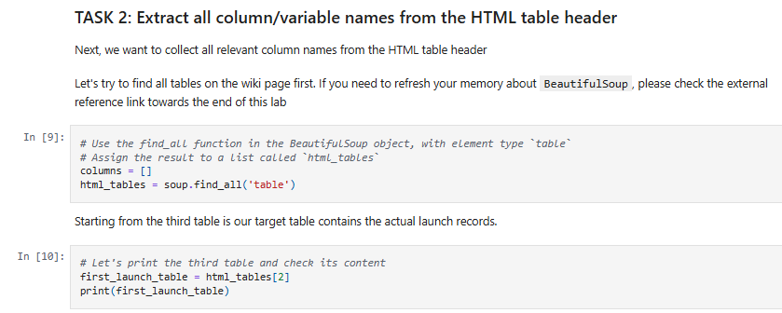
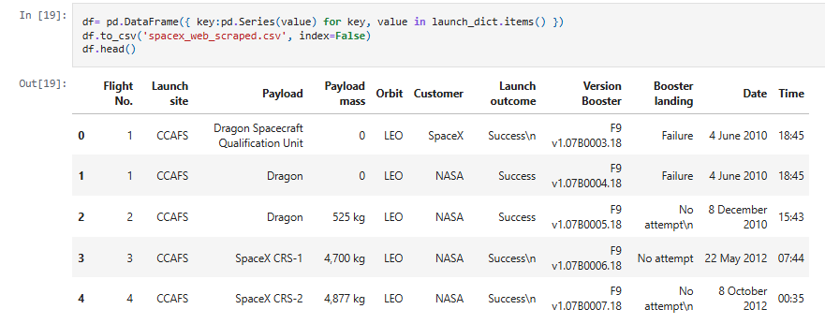
Data Collection Scraping
Falcon 9 launch records are Web scrapped with BeautifulSoup
Falcon 9 launch records with HTML table from Wikipedia are extracted.
Table are parsed and converted into a Pandas data frame
GitHub URL of the completed web scraping notebook
jupyter-labs-webscraping.ipynb

Slide 10
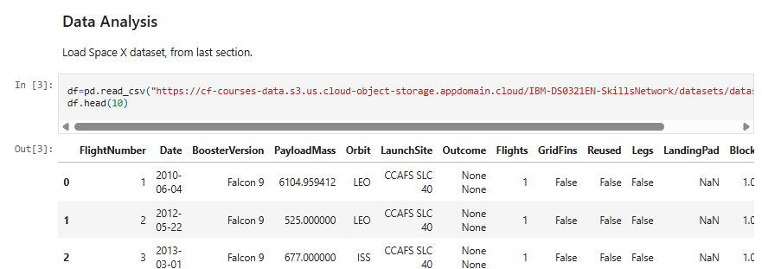
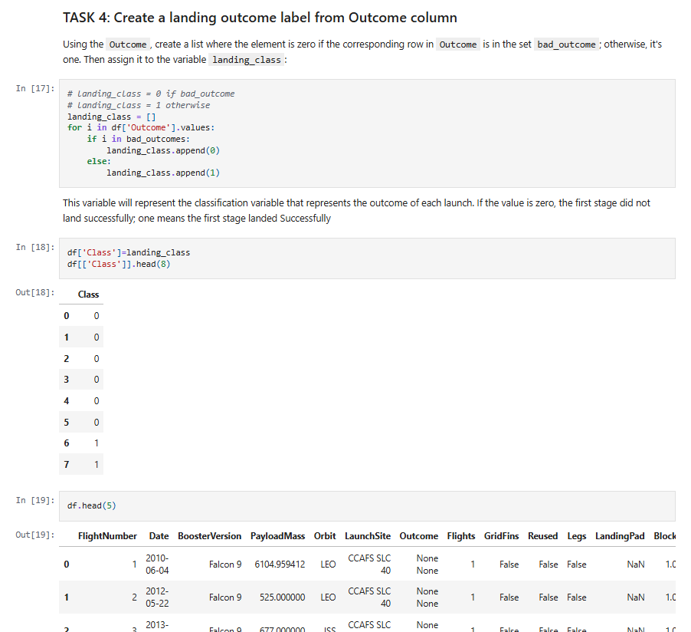
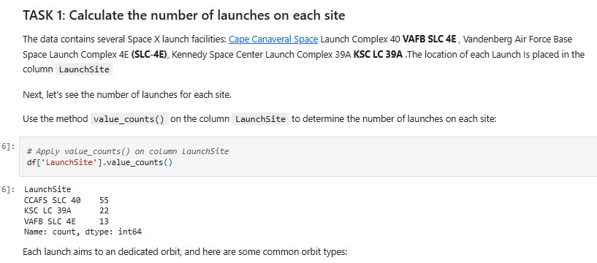
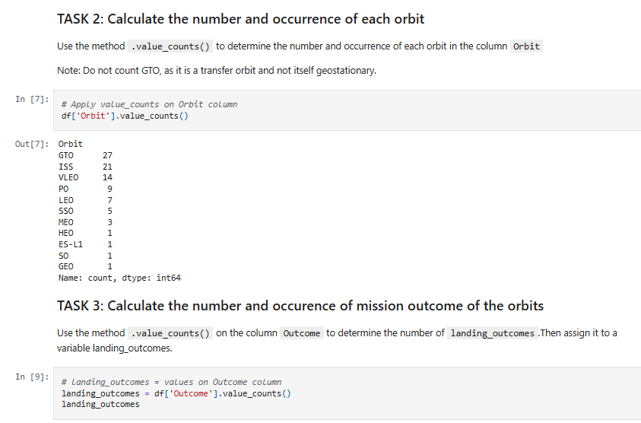
Data Wrangling
Exploratory Data Analysis is performed, and training labels are determined.
You need to present your data wrangling process using key phrases and flowcharts
GitHub URL: labs-jupyter-spacex-Data.ipynb

Slide 11
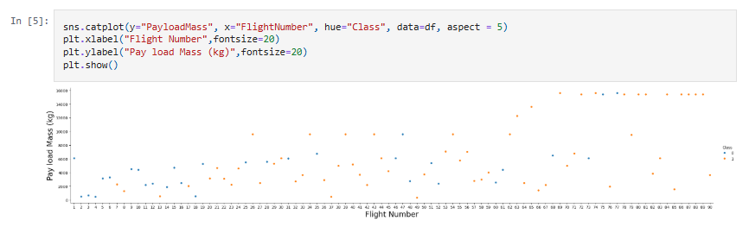
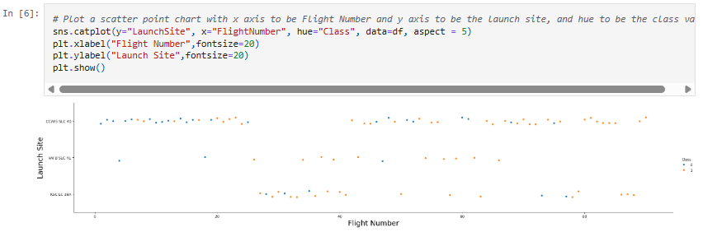
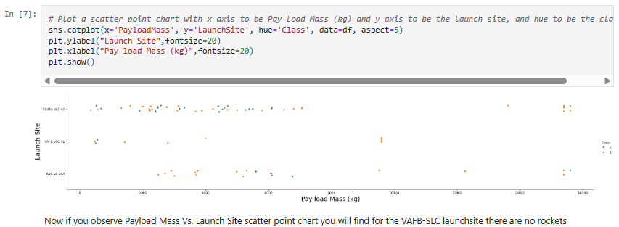
EDA with Data Visualization
Flight Number vs Payload Mass (Scatter plot): shows how flight experience and payload relate to success.
Flight Number vs Launch Site (Scatter plot): compares success rate trends across different launch sites.
Payload Mass vs Launch Site (Scatter plot): explores how payload size and site affect mission outcomes.
Success Rate by Orbit Type (Bar chart): highlights which orbit types achieve higher success.
Flight Number vs Orbit Type (Scatter plot): shows how flight experience influences orbit-specific success.
Payload Mass vs Orbit Type (Scatter plot): examines how payload affects success across orbit categories.
Yearly Launch Success Trend (Line chart): tracks how launch success improved over time.
GitHub URL: edadataviz.ipynb

Slide 12
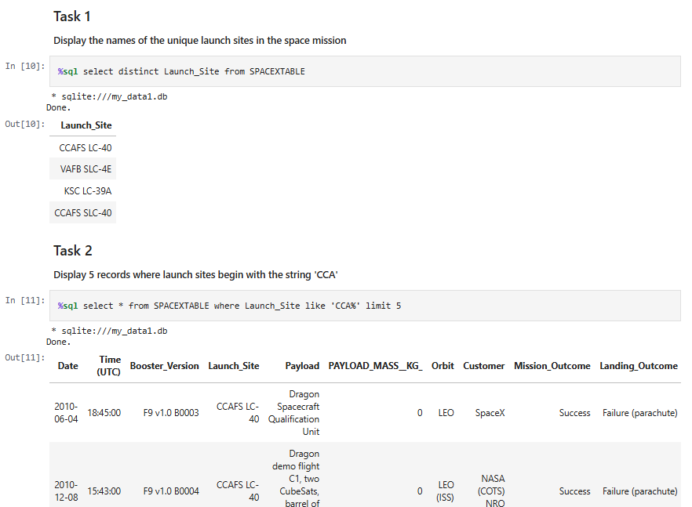
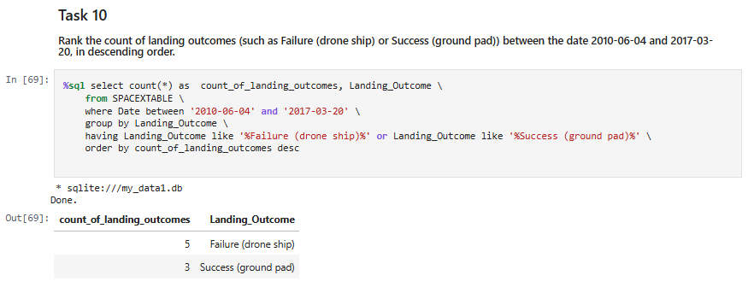
EDA with SQL
Summary:
Displayed unique launch sites using DISTINCT
Filtered records for launch sites starting with 'CCA' using LIKE
Calculated total payload mass for NASA CRS missions using SUM
Found average payload mass for F9 v1.1 boosters using AVG
Identified first successful ground pad landing date using MIN
Listed boosters with drone ship success and medium payload range
Counted mission outcomes by type using GROUP BY
Found boosters carrying maximum payload using subquery with MAX
Displayed 2015 drone ship failures with month names using CASE
Ranked landing outcomes between specific dates using COUNT and ORDER BY
GitHub URL: jupyter-labs-eda-sql-cour.ipynb

Slide 13
Build an Interactive Map with Folium
Base Map: Foundation with NASA JSC as center point
Circle Markers: Highlighted zones around each launch site location
Label Markers: Text labels showing launch site names
Cluster Markers: Grouped success/failure indicators with color coding (green/red)
Mouse Position: Real-time coordinate display for precise measurements
Distance Markers: Display calculated distances to nearby landmarks
GitHub URL: lab_jupyter_launch_si.ipynb

Slide 14
Build a Dashboard with Plotly Dash
Success vs Failure Pie Chart: Shows launch success distribution by site or overall to compare site performance.
Payload vs Success Scatter Plot: Visualizes how payload mass affects launch success, colored by booster version.
Launch Site Dropdown: Allows filtering data by specific launch site to focus on site-specific trends.
Payload Range Slider: Enables filtering by payload mass range to analyze success correlation within specific payload intervals.
Why added: To provide an interactive tool for analyzing launch success patterns across different sites, payload masses, and booster versions, helping identify key success factors.
Github URL: spacex-dash-app.py

Slide 15
Predictive Analysis (Classification)
Data Loading
Feature/Label Preparation
Data Standardization
Train-Test Split
Model Selection (Logistic Regression, SVM, Decision Tree)
Hyperparameter Tuning via GridSearchCV
Model Evaluation
Performance Comparison
Best Model Selection
Key Development Steps:
Data Preparation: Loaded and prepared features (X) and target labels (Y)
Preprocessing: Standardized features using StandardScaler
Data Splitting: 80% training, 20% testing with random state for reproducibility
Model Selection: Implemented three classifiers (Logistic Regression, SVM, Decision Tree)
Hyperparameter Optimization: Used GridSearchCV with 10-fold cross-validation
Performance Evaluation: Compared accuracy scores and confusion matrices
Best Model: Decision Tree achieved highest accuracy (86.25% training, 83.33% testing)
Final Results:
Logistic Regression: 84.64% (train)
SVM: 84.82% (train)
Decision Tree: 86.25% (train)
GitHub URL: SpaceX_Machine.ipynb

Slide 16
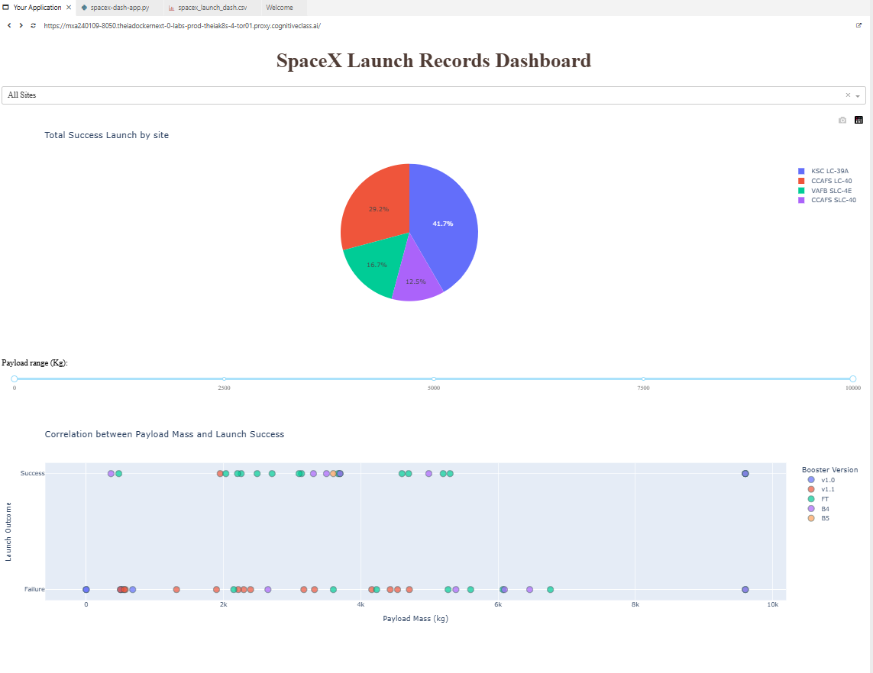
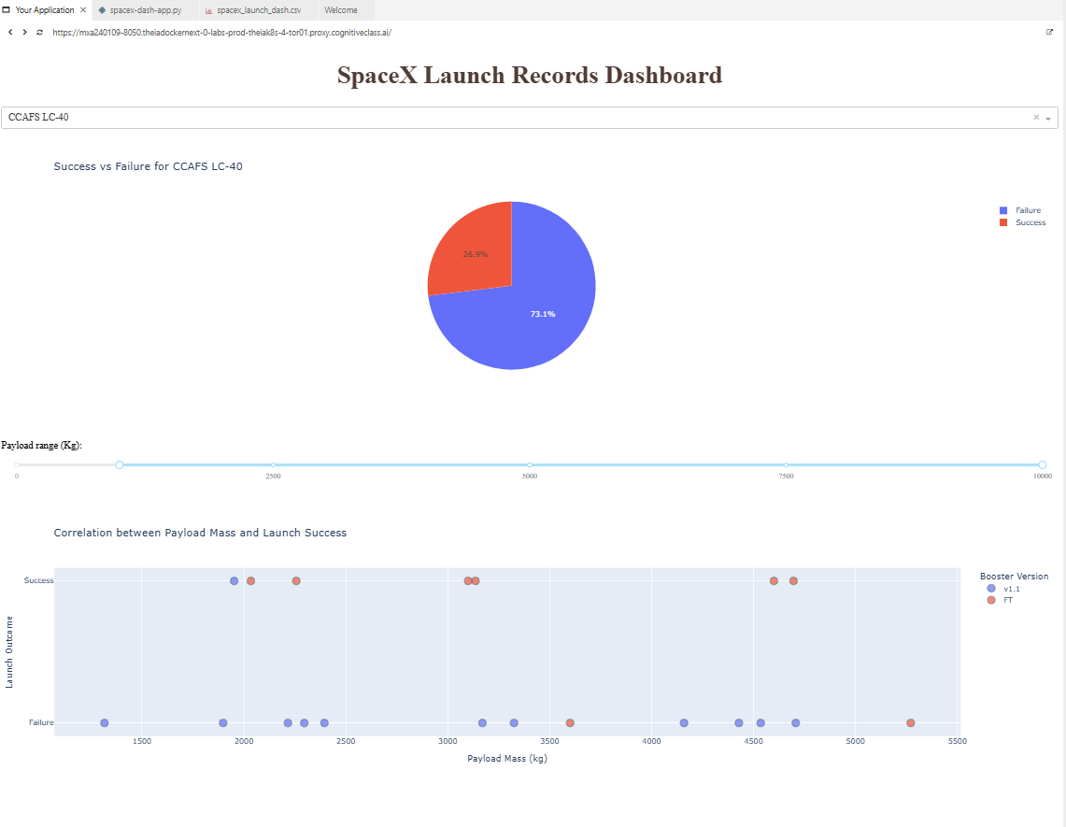
Results
Exploratory Data Analysis Results:
Dataset shape: 90 records × 18 features
Target variable: Class (0=No Landing, 1=Successful Landing)
Feature engineering: 83 dimensions after one-hot encoding
Data standardization applied using StandardScaler
Train-test split: 72 training samples, 18 test samples
Class distribution analysis in target variable
Predictive Analysis Results:
Three classification models evaluated: Logistic Regression, SVM, Decision Tree
Hyperparameter tuning via GridSearchCV with 10-fold cross-validation
Model performance rankings: Decision Tree (86.25%) > SVM (84.82%) > Logistic Regression (84.64%)
Best parameters: Decision Tree (max_depth=2, criterion='gini', max_features='sqrt')
Confusion matrix analysis revealed false positives as primary error type
Final model selection: Decision Tree classifier for Falcon 9 landing prediction

Slide 17

Section 2

Slide 18
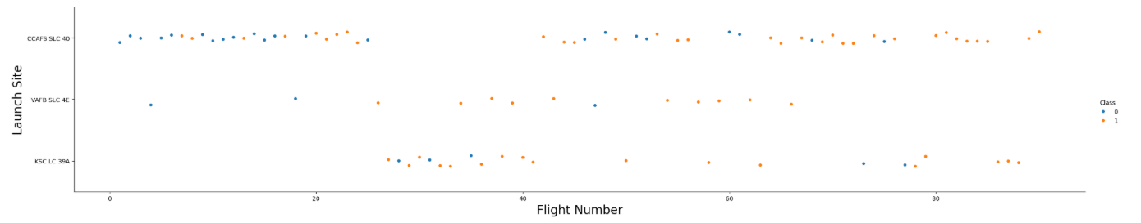
Flight Number vs. Launch Site
The scatter plot of Flight Number versus Launch Site, a clear temporal and success-based pattern emerges across the different launch facilities. The CCAFS SLC 40 site shows a distinct progression, starting with several early launch failures before achieving a consistent streak of successes in its higher-numbered, more recent flights. In contrast, the VAFB SLC 4E site demonstrates a nearly perfect success record from its very first flight, with almost all points belonging to the success class. The KSC LC 39A site appears to have entered operation later, as its flights begin at a higher flight number, and it also maintains a high success rate, with only one early failure visible in its flight history. This visualization effectively illustrates each site's operational learning curve and historical reliability.

Slide 19
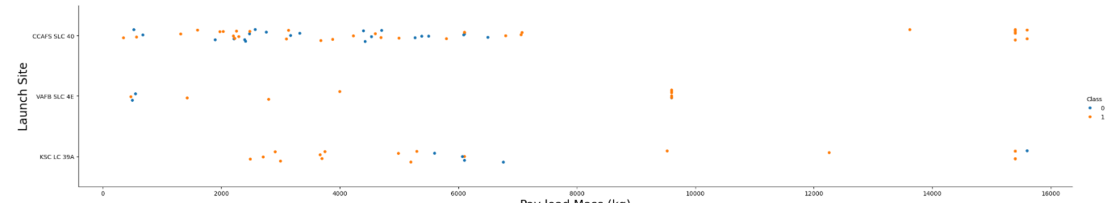
Payload vs. Launch Site
The plot of Payload Mass versus Launch Site reveals distinct launch trends and payload capabilities across different SpaceX launch sites. CCAFS SLC-40 and KSC LC-39A handle a wide range of payload masses, with successful landings (Class 1) becoming more frequent over time, particularly for medium to heavy payloads. VAFB SLC-4E is used exclusively for lighter payloads, as confirmed by the absence of any launches with payload masses exceeding 10,000 kg. This suggests VAFB SLC-4E is specialized for missions requiring polar orbits with smaller payloads, whereas the other sites support heavier missions, including those to GTO and ISS.

Slide 20
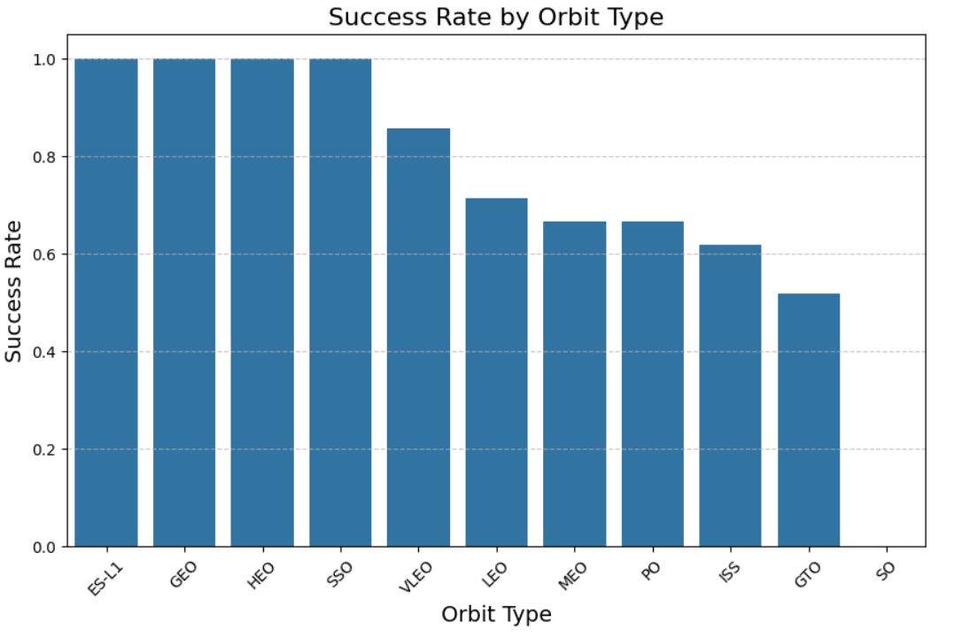
Success Rate vs. Orbit Type
The success rate is highly dependent on the mission's target orbit. Orbits that require less energy for the rocket's first stage to return to a landing site, such as Low Earth Orbit (LEO) and particularly ISS missions, show a very high success rate over time. In contrast, high-energy orbits like Geostationary Transfer Orbit (GTO) present a much greater challenge. GTO missions require the rocket to achieve a much higher velocity, leaving less fuel for the booster's return journey and landing maneuvers. This results in a notably lower success rate for GTO compared to LEO missions.

Slide 21
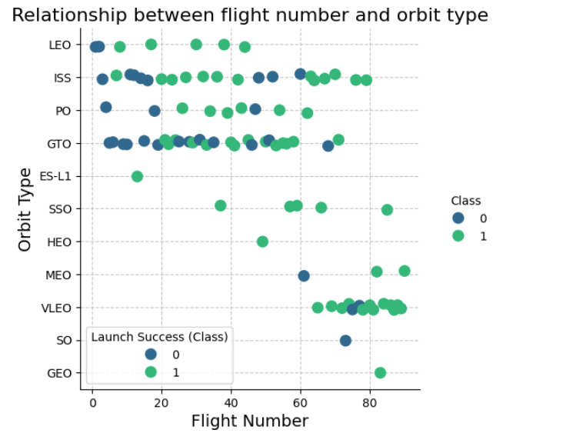
Flight Number vs. Orbit Type
This plot shows how SpaceX's launch manifest has diversified and evolved over time (as Flight Number increases). Initially, missions were concentrated on simpler, lower-energy orbits like LEO. As the company gained experience (higher Flight Numbers), it began to undertake a much wider variety of complex missions, regularly launching to high-energy orbits like Geostationary Transfer Orbit (GTO), the ISS, and specialized orbits such as Polar (PO) and Heliocentric missions. The scatter plot effectively visualizes this operational expansion, demonstrating that SpaceX progressed from mastering basic launches to simultaneously managing a portfolio of missions to multiple different orbit types from different launch sites.

Slide 22
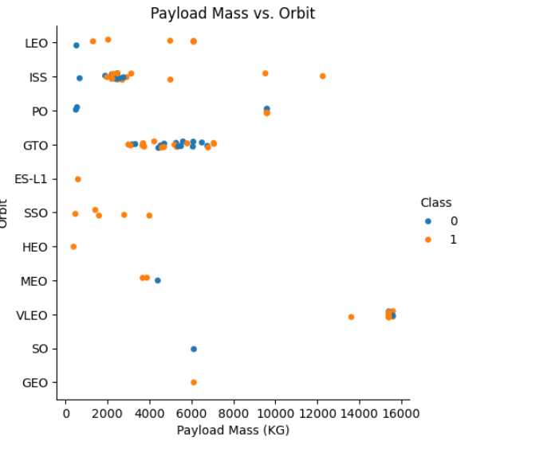
Payload vs. Orbit Type
This plot demonstrates a clear correlation between the target orbit and the mass of the payload the rocket can carry. With heavy payloads the successful landing or positive landing rate are more for Polar,LEO and ISS. However, for GTO, it's difficult to distinguish between successful and unsuccessful landings as both outcomes are present. Orbits requiring the most energy to reach, specifically the Geostationary Transfer Orbit (GTO), consistently carry the heaviest payloads, occupying the upper mass range on the plot. In contrast, missions to the International Space Station (ISS), which is in a relatively accessible Low Earth Orbit, carry medium-mass payloads. The Polar Orbit (PO) and other specialized orbits like Heliocentric missions consistently carry the lightest payloads. This pattern directly reflects the rocket's performance envelope: reaching higher-energy orbits consumes more fuel, leaving less capacity for payload mass, which is why the heaviest payloads are reserved for the less energetically demanding GTO missions launched from the east coast to take advantage of the Earth's rotation.

Slide 23
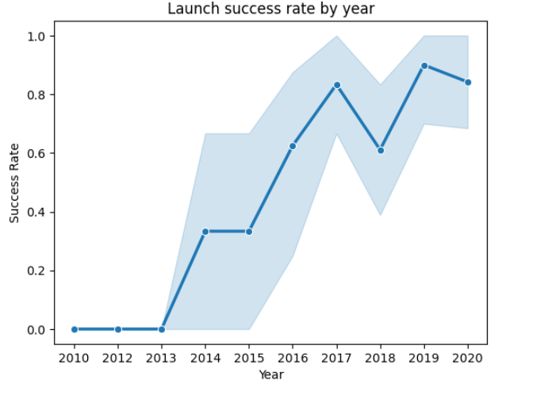
Launch Success Yearly Trend
The success rate since 2013 kept increasing till 2020

Slide 24
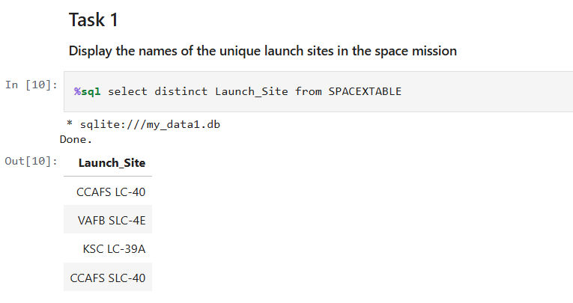
All Launch Site Names
Using Distinct keyword to get unique launch site names.

Slide 25
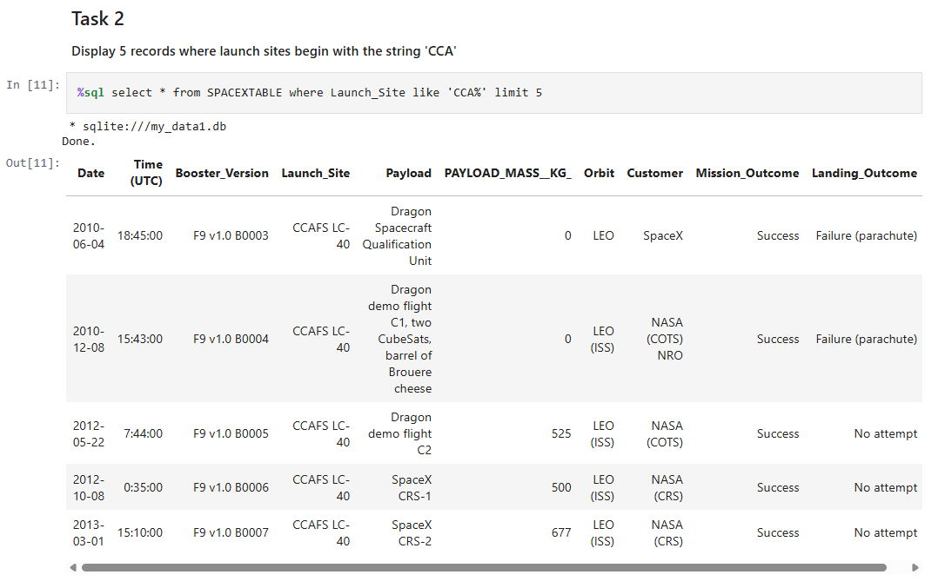
Launch Site Names Begin with 'CCA'
Showing 5 records where launch sites begin with `CCA`. Using Like keyword to get launch site starts with CCA and use limit to get only 5 results.

Slide 26
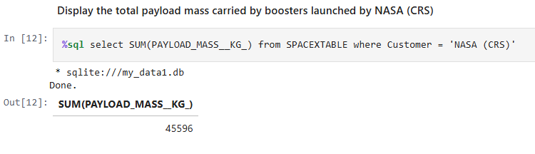
Total Payload Mass
The total payload carried by boosters from NASA is calculated using SQL. Use SUM to add all payload mass and where clause to filter NASA customer only.

Slide 27
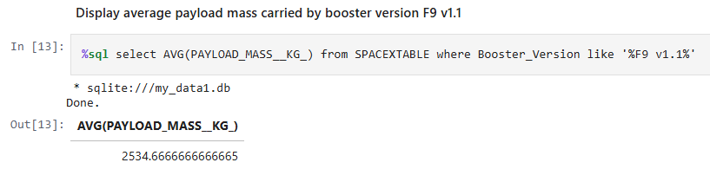
Average Payload Mass by F9 v1.1
The average payload mass carried by booster version F9 v1.1 is calculated in SQL using AVG function and filter booster version for F9 v1.1 using where clause.

Slide 28
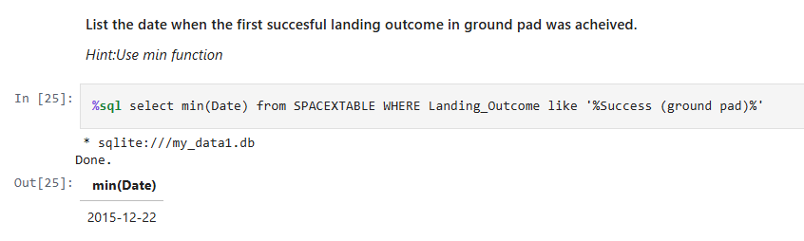
First Successful Ground Landing Date
The dates of the first successful landing outcome on ground pad is find out using SQL query using MIN function and filtering landing outcome using where and like clause restrict to ground landing.

Slide 29
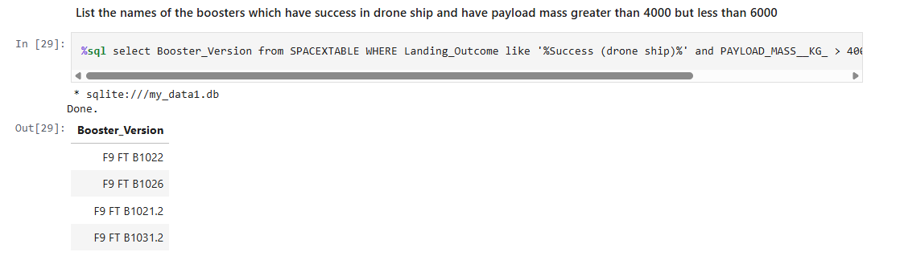
Successful Drone Ship Landing with Payload between 4000 and 6000
The names of boosters which have successfully landed on drone ship and had payload mass greater than 4000 but less than 6000 are listed using SQL Query with where clause to limit between 4000 and 6000. and filtering out the successful drone ship landing using LIKE.

Slide 30
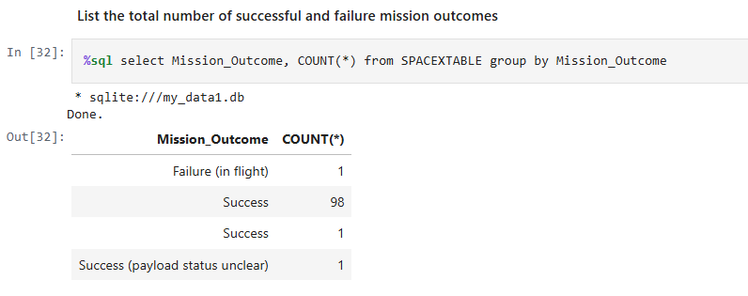
Total Number of Successful and Failure Mission Outcomes
The total number of successful and failure mission outcomes are calculated using SQL query using groupby clause and count function.

Slide 31
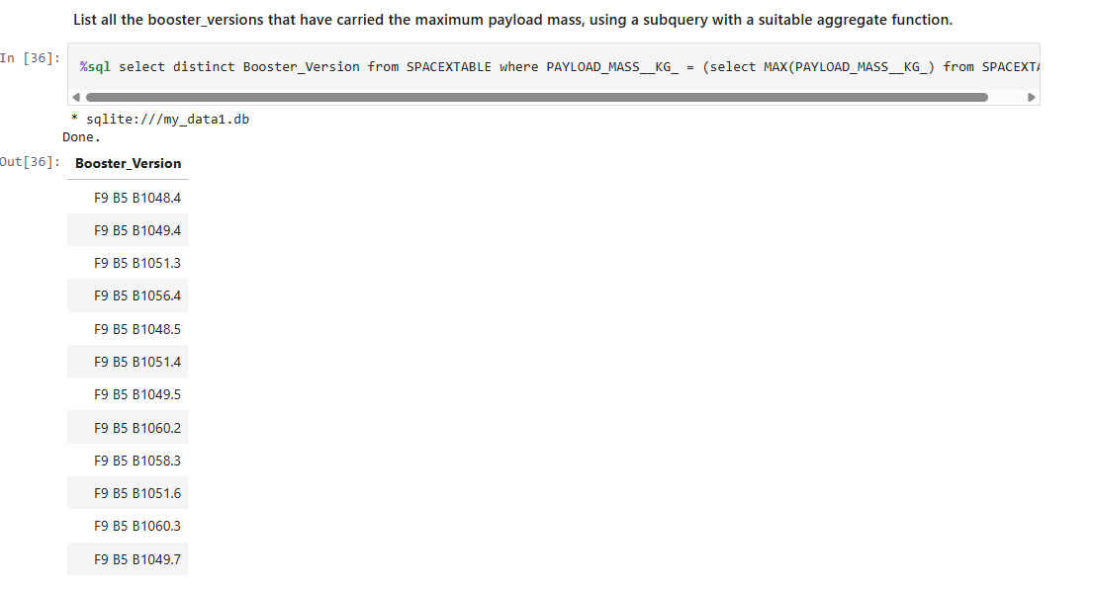
Boosters Carried Maximum Payload
The names of the booster which have carried the maximum payload mass are listed by using subquery to querying booster version with payload matching with max payload.

Slide 32
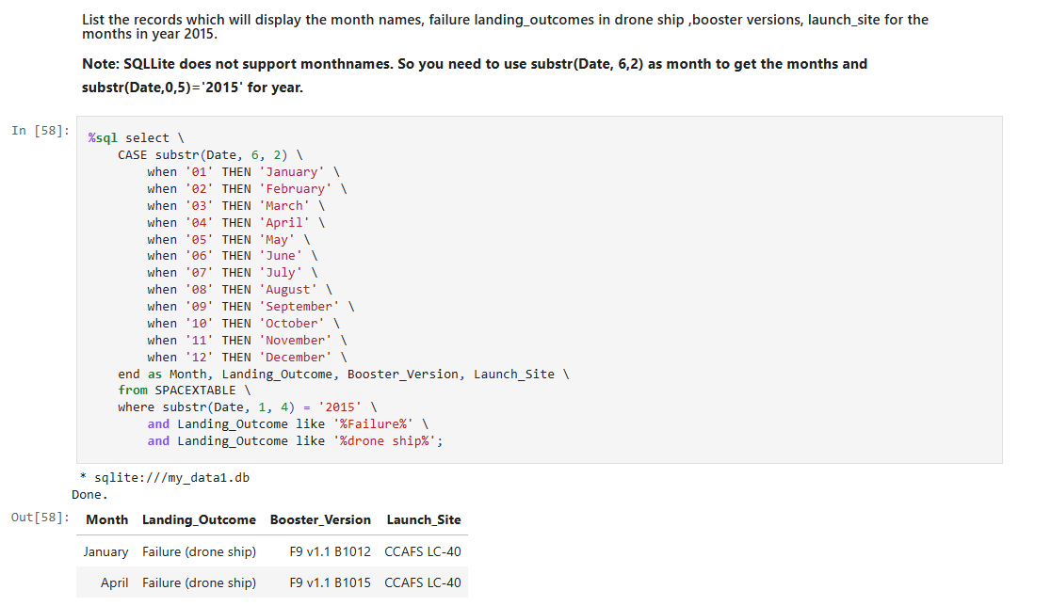
2015 Launch Records
The failed landing_outcomes in drone ship, their booster versions, and launch site names for in year 2015 are listed substring function to match year 2015 and like to match landing outcome with drone ship failure.

Slide 33
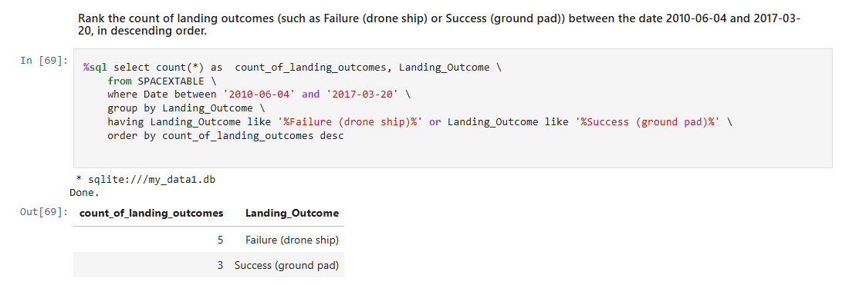
Rank Landing Outcomes Between 2010-06-04 and 2017-03-20
The count of landing outcomes (such as Failure (drone ship) or Success (ground pad)) between the date 2010-06-04 and 2017-03-20 are listed in descending order using group by clause with Landing outcome the use having clause to filter only drone ship failure and ground pad success and order desc and filter for the date using where.

Slide 34

Section 3

Slide 35
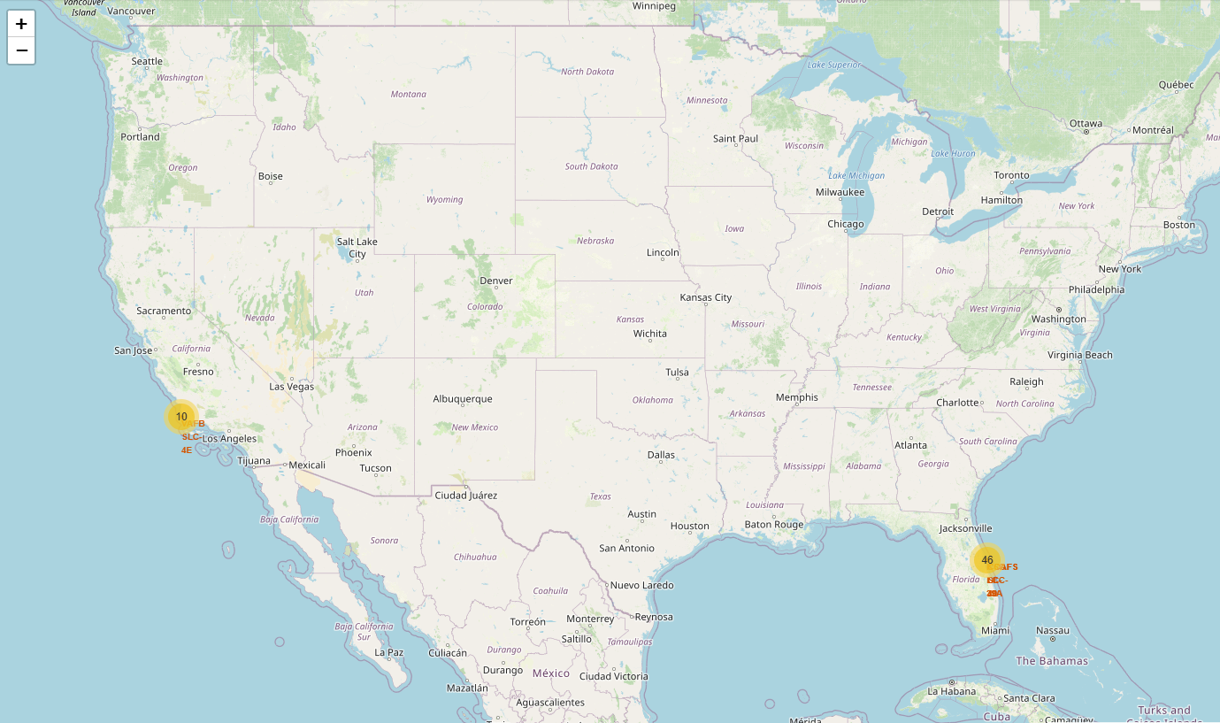
Global Distribution of SpaceX Launch Sites
46 launch sites in Florida and 10 on California. Most of them near coastline.

Slide 36
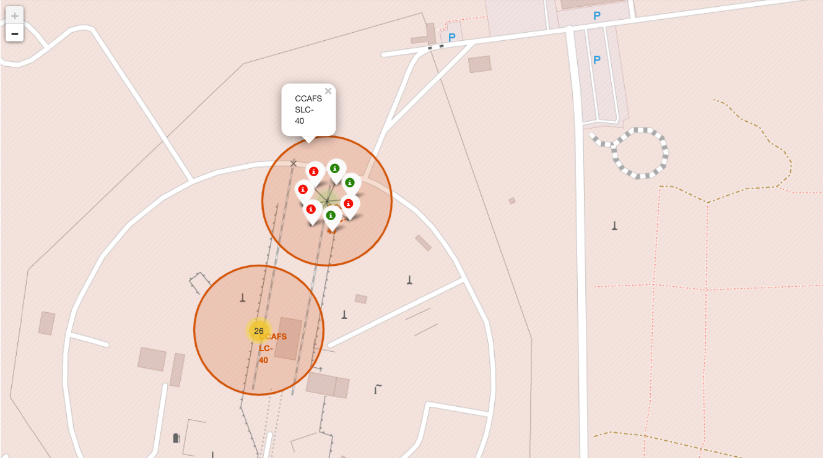
SpaceX Launch Outcomes by Site: Success and Failure Distribution
The screenshot zooms into the primary launch sites at Cape Canaveral (CCAFS LC-40, CCAFS SLC-40, KSC LC-39A) and Vandenberg (VAFB SLC-4E), displaying color-coded markers clustered by launch outcome. green for success and red for failure. The visualization clearly shows CCAFS SLC-40 exhibits a mix of outcomes with several visible failures.

Slide 37
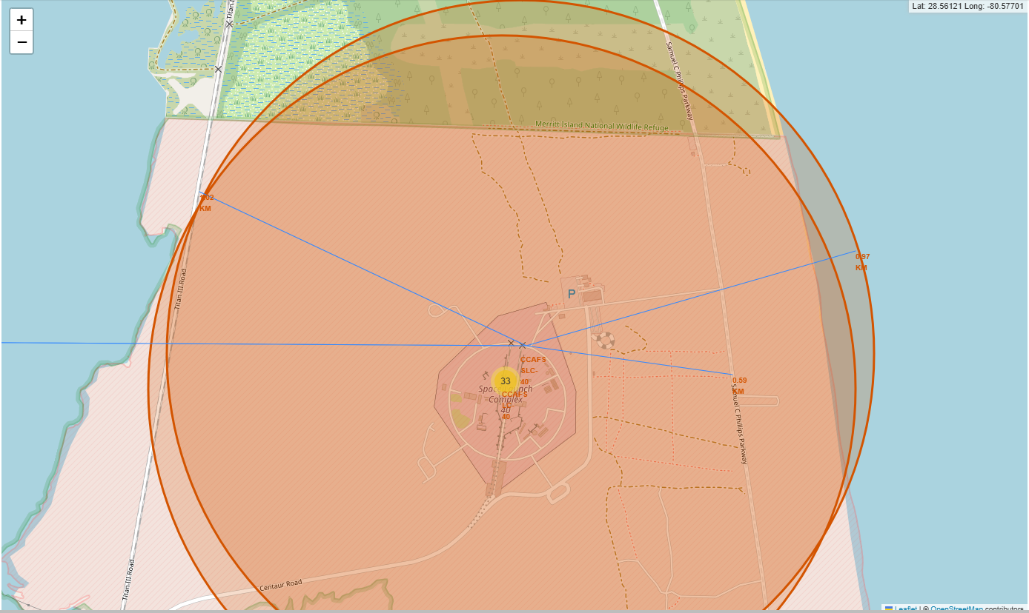
Proximity Analysis: CCAFS SLC-40 Launch Site and Nearby Infrastructure
The screenshot focuses on the CCAFS SLC-40 launch site, displaying its immediate surroundings and key infrastructure elements with calculated distances. Visible elements include:
Coastline (0.97 km away) - marked with a distance label, showing the site's immediate access to open water for safe launch trajectories
Highway/Transportation routes (0.59 KM)- visible as major roads near the launch complex
Railway lines (1.02 KM) - running parallel to the coast, supporting heavy payload transport
City (67.74 KM) – Its far away from major city like Orlando to avoid destruction and hamper densely populated area from debris of failed launch.

Slide 38

Section 4

Slide 39
Successful Launches by Site
KSC-LA-39A has the most count of launch success.

Slide 40
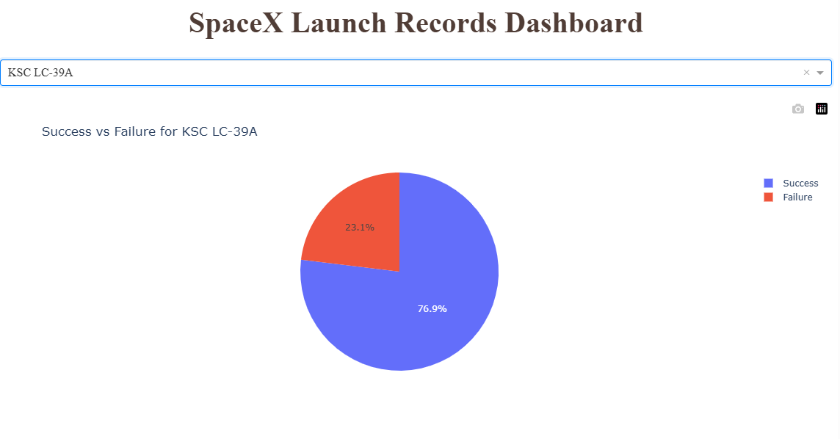
Most Successful Launch Site
KSC LC 39A outperforms other SpaceX launch facilities (~77% Success Rate)
May be the preferred location for high-value or crewed missions
Demonstrates SpaceX's ability to maintain consistent launch excellence

Slide 41
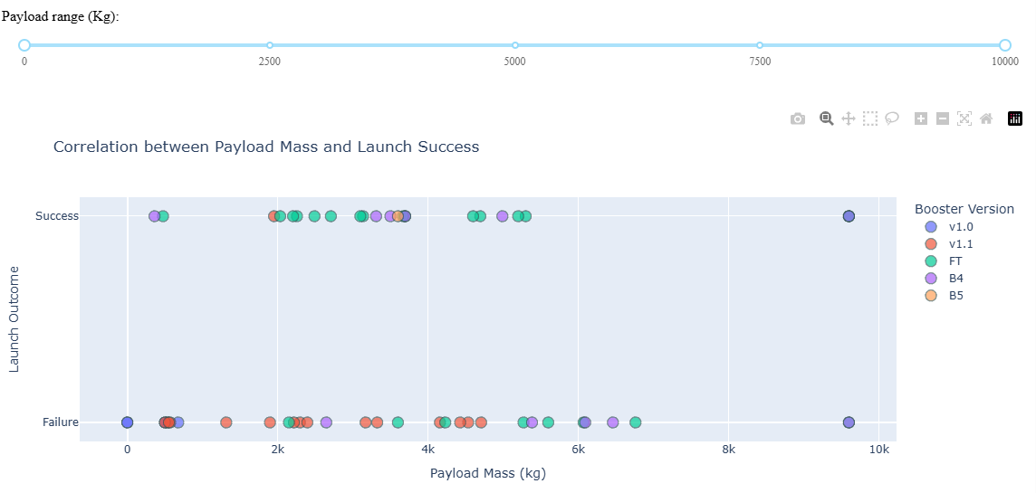
Payload vs Launch Outcome Over Booster Version
FT Booster version has the largest success rate.
Payload range between 2500 to 4000 KG has the highest launch success rate.
Payload range below 2000 KG has the lowest success rate.

Slide 42

Section 5

Slide 43
Classification Accuracy
Visualize the built model accuracy for all built classification models, in a bar chart
Find which model has the highest classification accuracy

Slide 44
Confusion Matrix
Show the confusion matrix of the best performing model with an explanation

Slide 45
Conclusions
Point 1
Point 2
Point 3
Point 4
…

Slide 46
Appendix
Include any relevant assets like Python code snippets, SQL queries, charts, Notebook outputs, or data sets that you may have created during this project

Slide 47


